Slide 1
Microcomputer Principles
&
Computer Interface
Lu Yin
luyin@nwpu.edu.cn

Slide 2
Chapter 11 I/O Programming
Contains
  Code assembly language instructions to read and write data to and from I/O ports
  Diagram the design of peripheral I/O to do buffered I/O
  List the difference in memory-mapped I/O versus peripheral I/O
  Do buffered I/O with 8255 IC
  Program 8255 to do buffered I/O

Slide 3
Section11.1
8088 Input/Output Instructions
I/O ports
  Address space allocated for peripheral devices are called Ports; Ports contain data only;
  The x86 CPU is one of the few processors that have I/O space in addition to memory space; The mem/~IO pin of 8088 distinguish port address from memory address;
  In x86 system, ports can be 8-bit data or 16-bit data; And address assigned to ports can be 8-bit or 16-bit also;
  Special Input/Output instructions is used to do data exchange between the accumulator and ports (AL with 8-bit ports, and AX with 16-bit ports);
Notes:
Peripheral devices also use Registers to hold data temporally.
Some registers can be accessed by outside host, the microprocessor. In such a case, the register works as an additional buffer connected to the DB of the processor. We call the data location provided by the buffer “Port” in case confused with a location within the memory.
The additional buffer needs an address, which is a Port Address within the IO Space.

Slide 4
Section11.1
8088 Input/Output Instructions
8-bit data ports
  8-bit data ports in 8088 is the most widely used;
  Input: IN destination, source
    In 8-bit input, the destination must be AL register
    The source should be a port address, port#; Immediate data or register indirect address can be applied to port#, and no segment address is required in calculating physical address;
    If port# is an immediate data, it is limited to 8-bit address, and only 256 ports may be accessed. For example: IN AL, 03H will input a byte from port address 03H;
    If port# use register indirect addressing mode, both 8-bit or 16-bit address are allowed. For example: MOV DX, 1023H; IN AL, DX;

Slide 5
Section11.1
8088 Input/Output Instructions
8-bit data ports
  Output: OUT destination, source
    In 8-bit output, the source operand must be AL register;
    The destination should be a port address, port#; Immediate data or register indirect address can be applied to port#, and no segment address is required in calculating physical address;
    If port# is an immediate data, it is limited to 8-bit address, and only 256 ports may be accessed. For example: OUT 03H, AL will output a byte to port address 03H;
    If port# use register indirect addressing mode, both 8-bit or 16-bit address is allowed. In such a case, only DX is allowed to be used in register indirect addressing mode. For example:
    MOV DX, 1023H;
    OUT DX, AL;

Slide 6
Section11.1
8088 Input/Output Instructions
Examples:
  The following program segment tires to output to port 43H
  MOV AL, 36H
  OUT 43H, AL
  The following program segment tries to input from port 300H and output to 302H
    MOV DX, 300H ;load dx with port address
    IN AL, DX ;bring in data
    MOV DX, 302H
    OUT DX, AL ;send it out

Slide 7
Section11.2
I/O Address Decoding and Design
Interface: the circuit between the source and the destination unit in data transmission buses.
The function of interfacing circuit:
  Address decoding; Bus isolation; Data buffering
On behalf of the CPU:
  An output interface should provide data buffering if the target device is too slow;
  A input interface should provide bus isolation between system bus and local bus;
In order to do address decoding:
  The control signals IOR/IOW are used along with the decoder;
  For an 8-bit port address, A0-A7 is decoded;
  If the port address is 16-bit, A0-A15 is decoded;

Slide 8
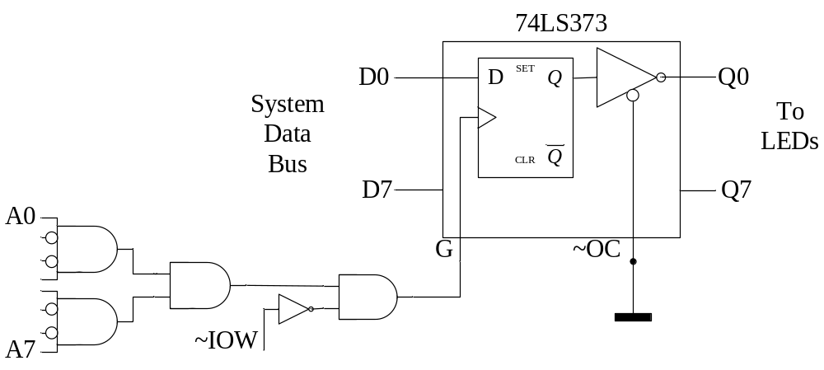
Section11.2
I/O Address Decoding and Design
Use 74LS373 for buffered output
  74LS373 is a D flip-flop latch IC
Design a circuit to do “OUT 99H,AL”

Slide 9
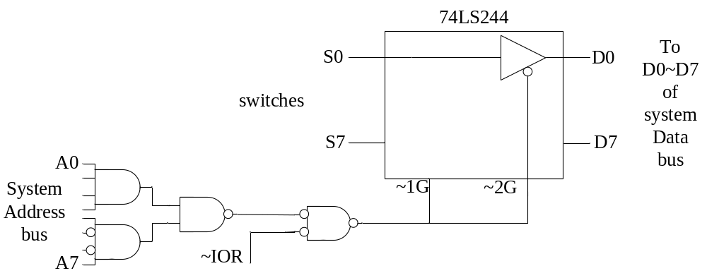
Section11.2
I/O Address Decoding and Design
Use 74LS244 for tri state input
  74LS244 is a tri-state driver
Design a circuit to do “IN AL, 9FH”

Slide 10
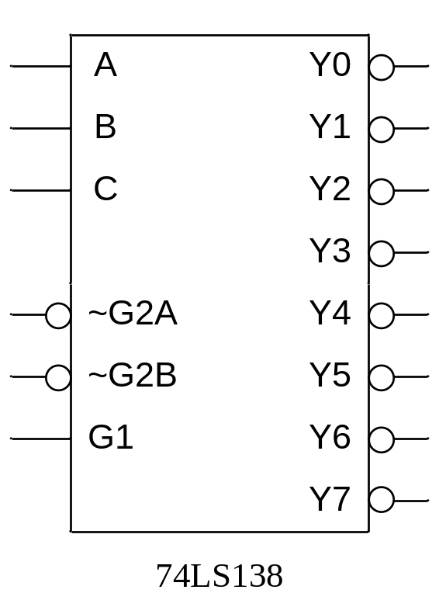
Section10.2
Memory Address Decoding
Using the 74LS138 as decoder
  74LS138 is a 3-to-8 decoder
  ABC are address inputs
  G1, G2A, G2B is control pin, and can be linked with both address bus and control bus

Slide 11
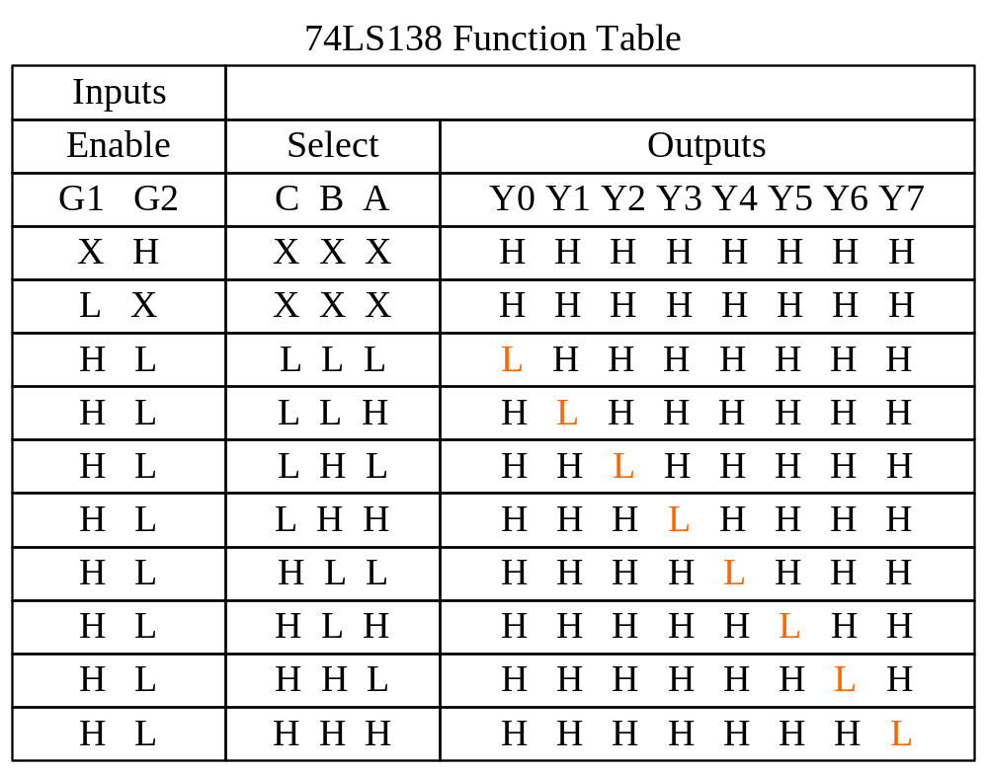
Section10.2
Memory Address Decoding

Slide 12
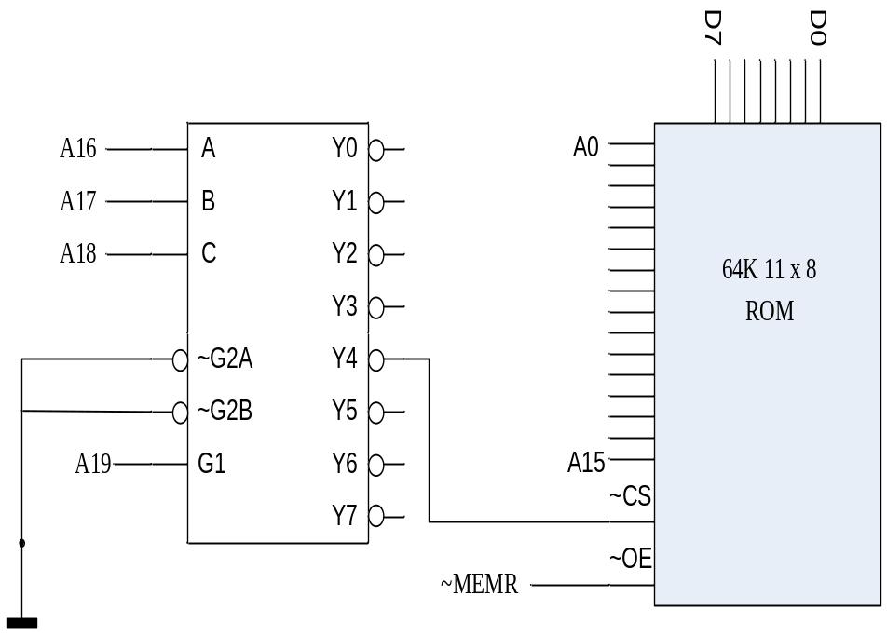
Section10.2
Memory Address Decoding
Calculate the address below: (Figure 10-12)
Solution:
Enable 74LS138 Encoder
  A19 = 1
Enable the output pin
  A18A17A16=100
Address range
  A15~A0 ranges from all low to all high. And that would be 2¹⁶ (=65536) bytes

Slide 13
Section11.2
I/O Address Decoding and Design
Peripheral I/O
  Communicating with I/O devices using I/O instructions is referred to as peripheral I/O or isolated I/O
  In peripheral I/O, I/O address space is isolated from memory space. And IOW/IOR signal is required
Memory I/O
  If a memory location is assigned to be an input or output port, it is called memory-mapped I/O
  There is no I/O instructions in memory I/O. The ports are accessed by MOV instructions
  To access memory mapped I/O ports, DS should be initialized

Slide 14
To implement a ARINC429 industry bus communication card, we can make use of a ARINC429 controller IC. When a 429 word is received of transmitted by the 429 controller, a interrupt request is generated. The host must read the interrupt status register within the 429 controller to find whether it is a Rx interrupt or a Tx interrupt. The status register is designed to be at port 0316H.
The function below is designed to do the judgment.
Void test_int()
{
int port_status_word;
int int_status_word;
port_status_word = 0x0316;
int_status_word = _Inp (port_status_word);
if(int_status_word & 0x04)
{
pritnf(“A word is transmited”);
}
}
Void test_int()
{
int* port_status_word;
port_status_word = 0x0316;
if(*port_status_word & 0x04)
{
pritnf(“A word is transmited”);
}
}

Slide 15
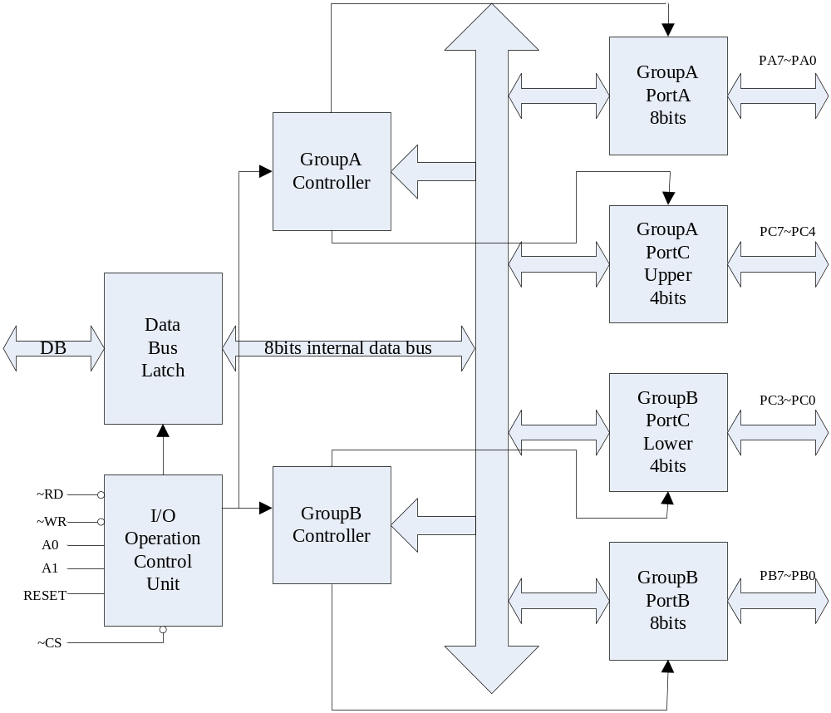
Section11.4
Programming and Interfacing the 8255
8255 is a 40 PIN latched I/O IC
  3 dual-direction ports
  Port C can be divided into upper and lower halves.
  Port C can be worked as control pin for port A and B, to contact with peripheral devices

Slide 16
Section11.4
Programming and Interfacing the 8255
PortA and PortB: can be programmed to be input and output
PortC (divided into CU and CL): can be input and output, and can be programmed separately
RD and WR: connect to IOR/IOW
RESET: clear the control register
A0, A1 and CS: CS is the chip enable pin; A0 and A1 is used to locate the internal register.
8255 Port Selection
CS | A1 | A0 | selects
0 | 0 | 0 | Port A
0 | 0 | 1 | Port B
0 | 1 | 0 | Port C
0 | 1 | 1 | Control reg
1 | x | X | disabled

Slide 17
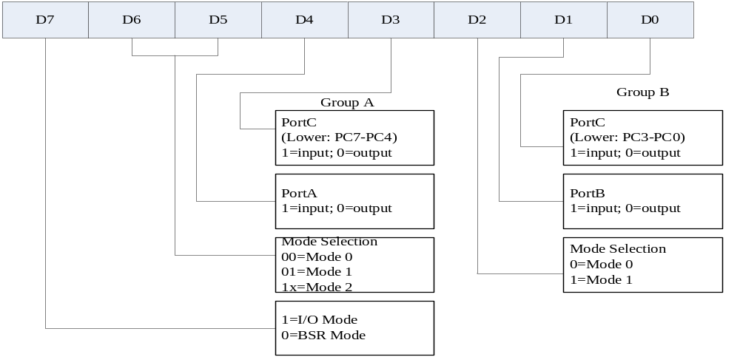
Section11.4
Programming and Interfacing the 8255
Mode selection of the 8255A
  The I/O direction and I/O mode is defined by the control register

Slide 18
Section11.4
Programming and Interfacing the 8255
8255 IO ports configuration
~CS | ~RD | ~WE | A1 A0 | operation
0 | 0 | 1 | 0 0 | Port A → DB
0 | 0 | 1 | 0 1 | Port B → DB
0 | 0 | 1 | 1 0 | Port C → DB
0 | 1 | 0 | 0 0 | DB → Port A
0 | 1 | 0 | 0 1 | DB → Port B
0 | 1 | 0 | 1 0 | DB → Port C
0 | 1 | 0 | 1 1 | DB → control register
1 | X | X | X X | No OP. (isolated)
0 | 0 | 1 | 1 1 | Illegal state
0 | 1 | 1 | X X | No OP. (isolated)

Slide 19
Example 11-4
(a)Find the control word if PA=OUT, PB=in, PC0-PC3=in, and PC4-PC7=out.
(b)Program the 8255 to get data from port A and send it to port B. In addition, data from PCL is sent out to the PCU.
Use port addresses of 300H-303H for the 8255 chip
Solution:
(a)The ctrl word is 83H(1000 0011B)
(b)The code is as follows
B8255C EQU 300H ;base address of 8255 chip
CNTL EQU 83H ;define the control word
MOV DX, B8255C+3 ;load ctrl reg. address
MOV AL,CNTL
OUT DX, AL ;setup the control word reg of 8255
MOV DX, B8255C+1 ;load PB address
IN AL, DX
MOV DX, B8255C ;load PA address
OUT DX, AL
MOV DX, B8255C+2 ;load PC address
IN AL, DX
AND AL, 0FH ;mask the upper bits, keep the lower bits AL
MOV CX, 4
ROL AL, CX
OUT DX, AL ;send PCL to PCU

Slide 20
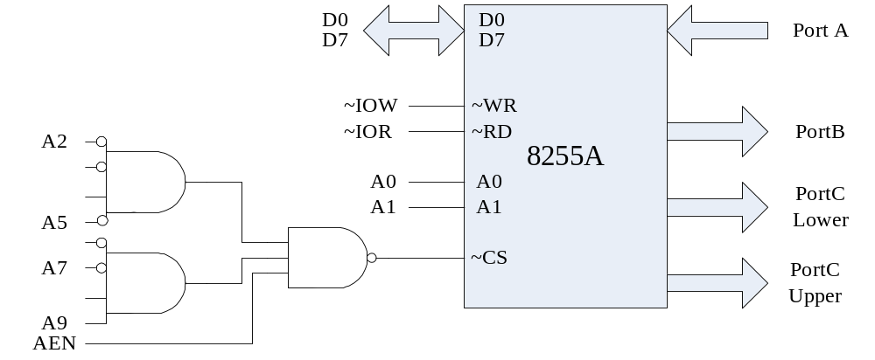
Figure 11-13 (example 11-5)

Slide 21
Example 11-5
The 8255 shown in figure 11-13 is configured as follows: portA as input, B as output, and all the bits of port C as output.
(a)Find the port addresses assigned to A, B, C and the control register.
(b)Find the control byte for this configuration
(c)Program the ports to input data from port A and send it to both PB and PC.
Solution:
(a)A2~A9 should be 310H to enable the ~CS, and A0~A2 should be left for internal ports
(b)The control word should be: 90H (1001 000B)
(c)The code is as follows
MOV AL, 90H ;ctrl byte
MOV DX, 31H ;load ctrl reg address
OUT DX, AL
MOV DX, 310H ;load PA address
IN AL, DX ;get the data from PA
MOV DX, 311H ;load PB address
OUT DX, AL ;send it to PB
MOV DX, 312H ;load PC address
OUT DX, Al ;and to PC

Slide 22
Section11.4
Programming and Interfacing the 8255
Buffering 300-31FH address range
Address assignment table requirements
Selector | Address | Assignment | Solution
Y0 | 300-303 | To 8255 | Need A0~A1
Y1 | 304-307 | To 8253 | Need A2=1 and A0~A1
Y2 | 308-30B | Available | A0,A1 besides A3=1
Y3 | 30C-30F | Available | A0,A1 besides A2=A3=1
Y4 | 310-313 | Available | So A2~A4 goes to ABC of138 Use A5~A9 to generate base 300H

Slide 23
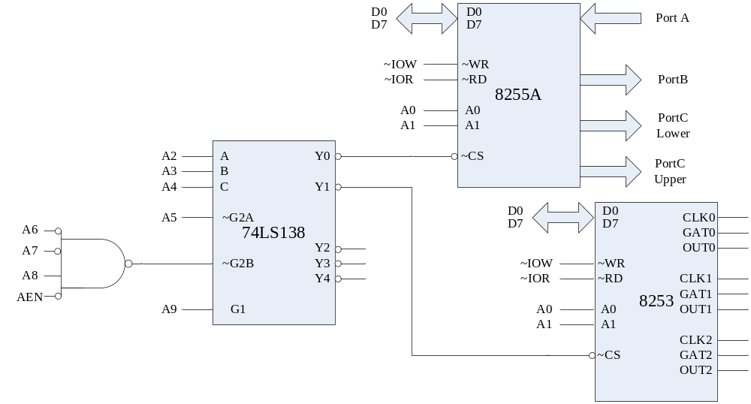
Figure 11-16

Slide 24
Section11.4
Programming and Interfacing the 8255
Visual C/C++ I/O Programming
Table11-5: I/O operations in Visual C++
X86 Assembly | Visual C++
OUT port#, AL | _outp(port#, byte)
OUT DX, AL | _outp(port#, byte)
IN AL, port# | _inp(port#)
IN AL, DX | _inp(port#)

Slide 25
Example 11-8
Write a Visual C++ program for windows to toggle all bits of PA and PB of the 8255 chip. Use the kbhit() function to exit if there is a keypress.
Solution:
#include <conio.h>
#include <stdio.h>
#include <iostream.h>
#include <iomanip.h>
#include <windows.h>
void main()
{
cout<<setiosflags(ios::unitbuf); //clear screen buffer
cout<<“This program toggles the bits for PortA and PortB.”;
_outp(0x303, 0x80); //Make PA, PB of 8255 all output
do
{
_outp(0x300, 0x55);
_outp(0x301, 0x55);
_sleep(500);
_outp(0x300, 0xAA);
_outp(0x301, 0xAA);
_sleep(500);
}
while(!kbhit());
}

